Slide 1

Bastille - Mantid
Project status

Slide 2
Summary Last PMC meeting
3 November 2016
Work on IN16B and TOF well advanced
IDFs (Instrument Definition Files) validated
First tests on IN16B and IN4 positive
Outstanding issues:
Absorption corrections
User interface (TOF)
IN5 case
Plotting tools

Slide 3
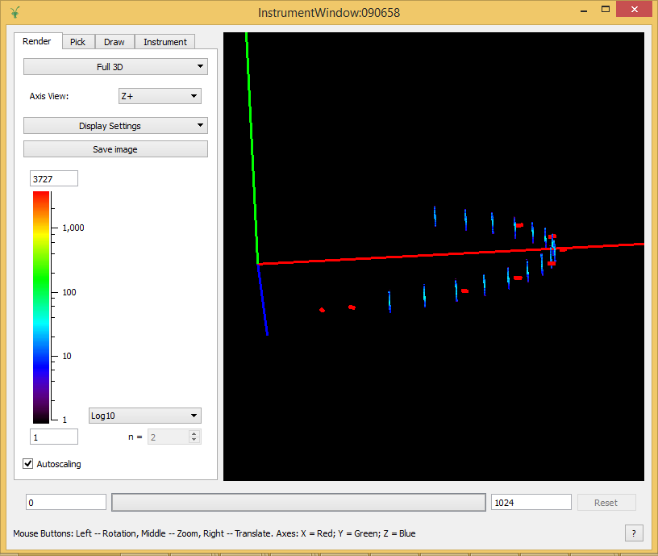
Status BS (IN16B)
Deployed on IN16B and tested by users during cycle 171
All modes (QENS, EFWS, IFWS) handled correctly
No major problems
Integrated in last Mantid release (3.9, Feb 2017)

Slide 4
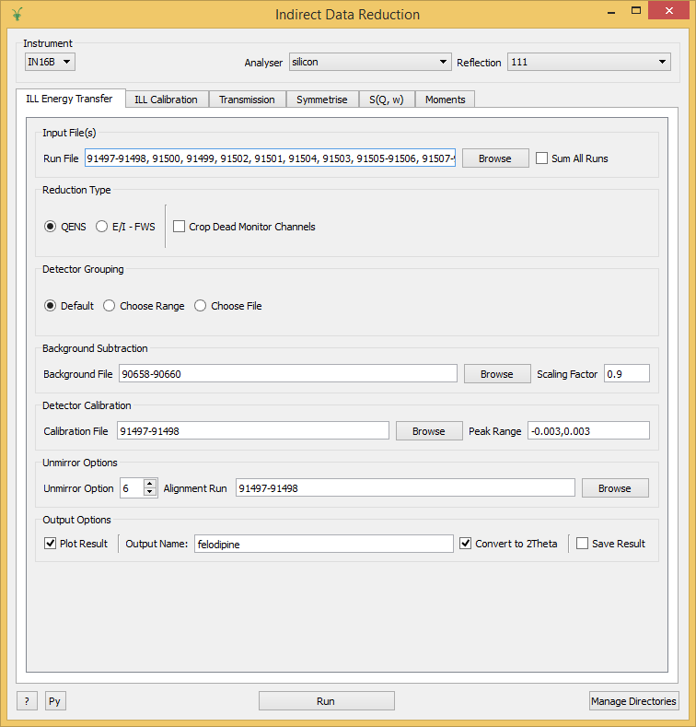
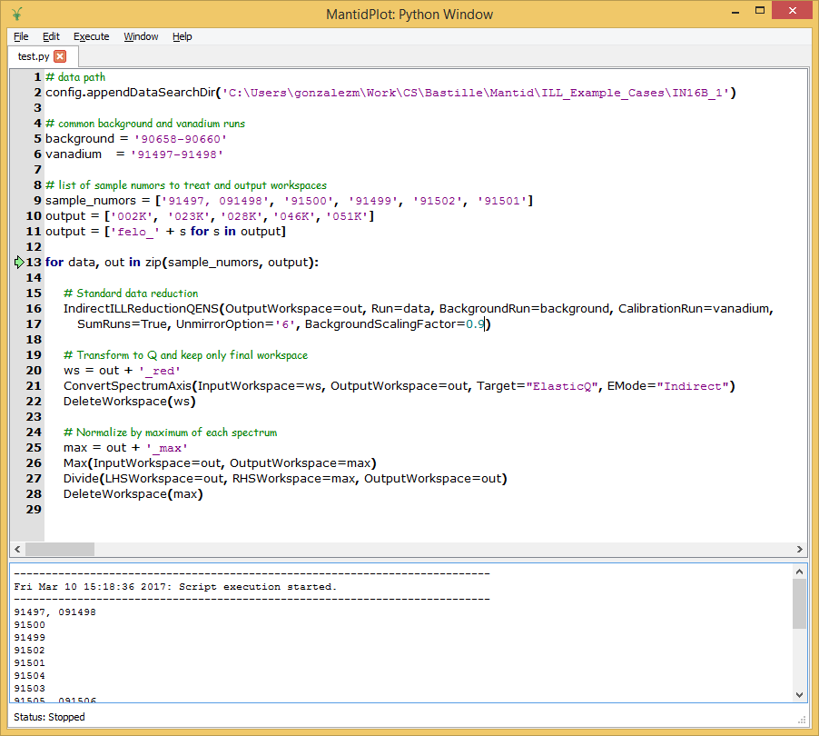
Status BS (IN16B)

Slide 5
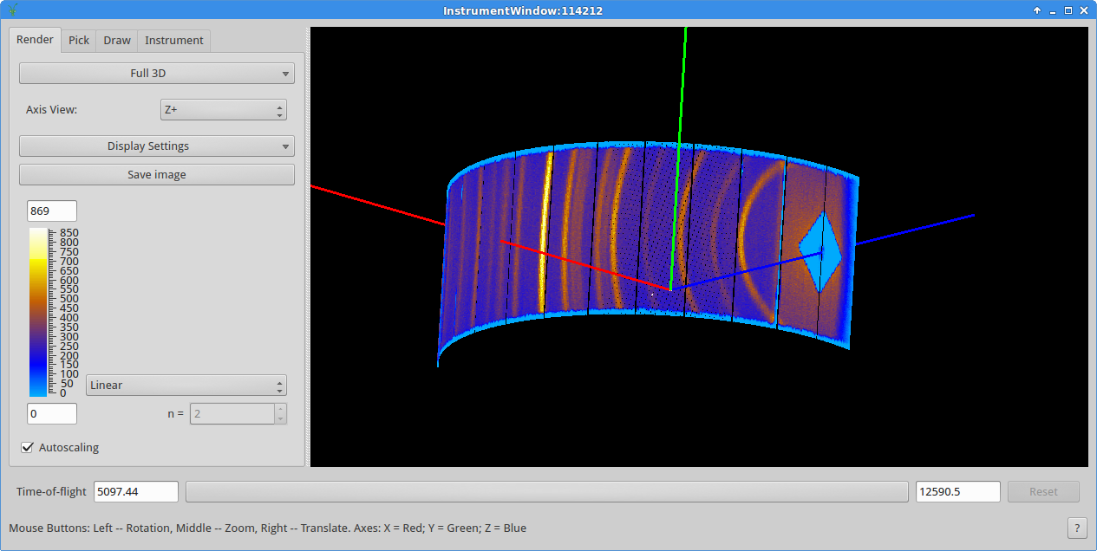
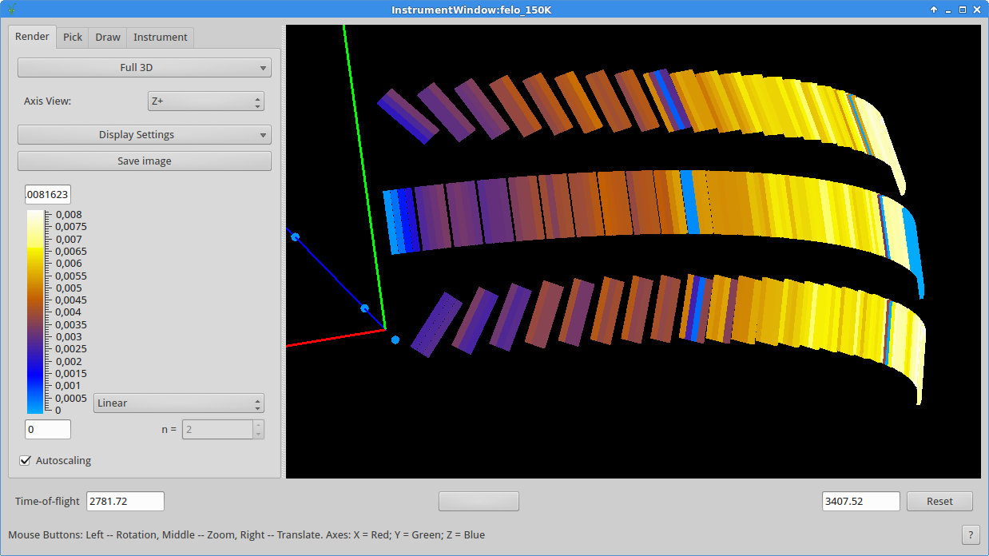
Status TOF
IN5
Added IN5
Split reduction work-flow
DirectILLCollectData
DirectILLDiagnostics
DirectILLIntegrateVanadium
DirectILLApplySelfShielding
DirectILLReduction
First tests positive
IN6

Slide 6
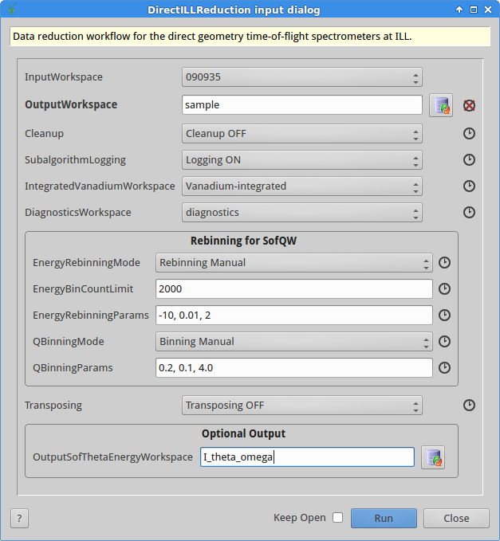
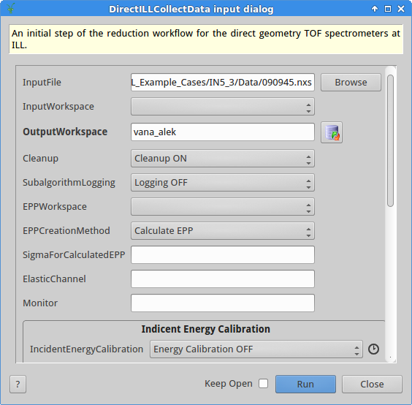
Status TOF

Slide 7
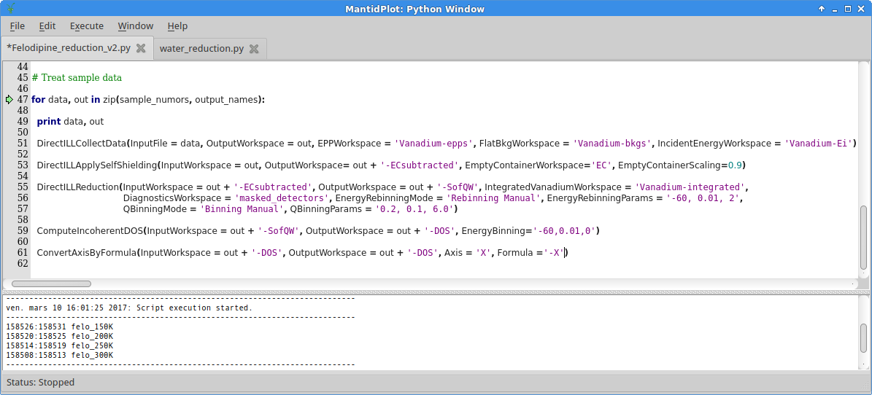
Status TOF

Slide 8
Status TOF
OUTSTANDING ISSUES:
New version of absorption corrections (ongoing work at ISIS)
Further quantitative validation
Global user interface
Specific plotting tools (python utilities - Matplotlib, Mslice, Slice viewer)
User feedback
DEMONSTRATION +TRAINING TO TOF-BS SCIENTISTS (31st MARCH)
DEPLOY IN IN4, IN5, IN6 FOR NEXT CYCLE (1st SEPTEMBER 2017)

Slide 9
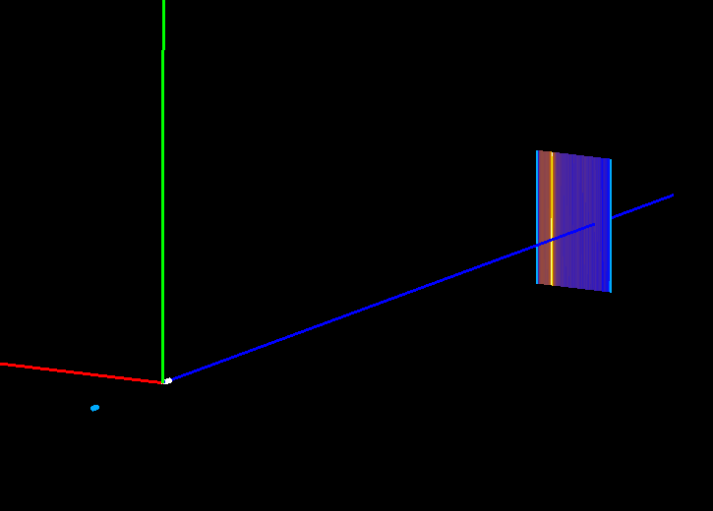
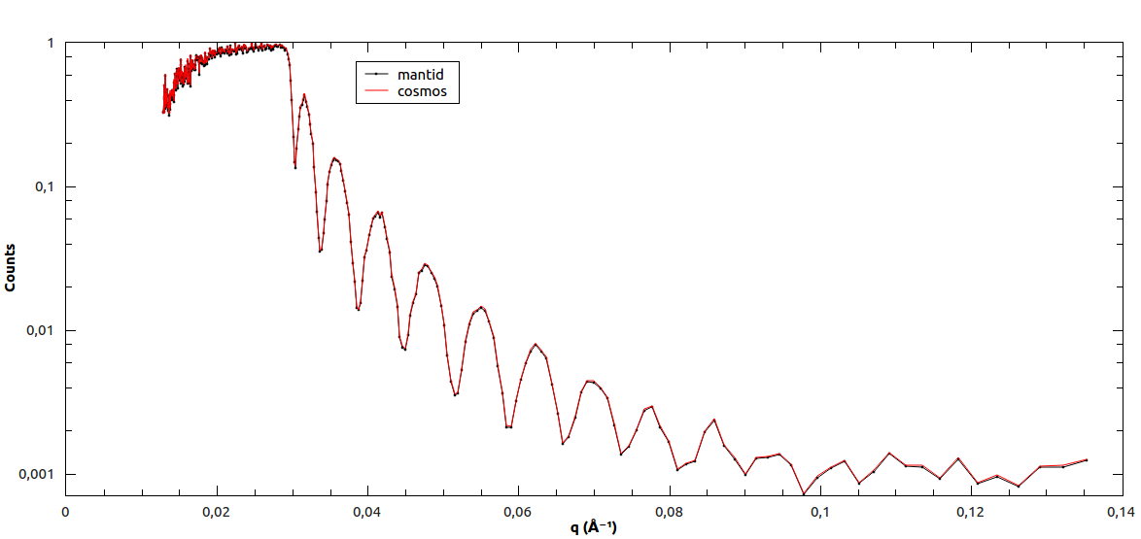
Reflectometry
D17
Loaders for D17 & Figaro
Simple basic script
Exploring existing algorithms and workflows
Several approaches at ISIS
Efficient handling of large datasets
December 2017:
Reduction workflow
“Cosmos-like” user interface

Slide 10
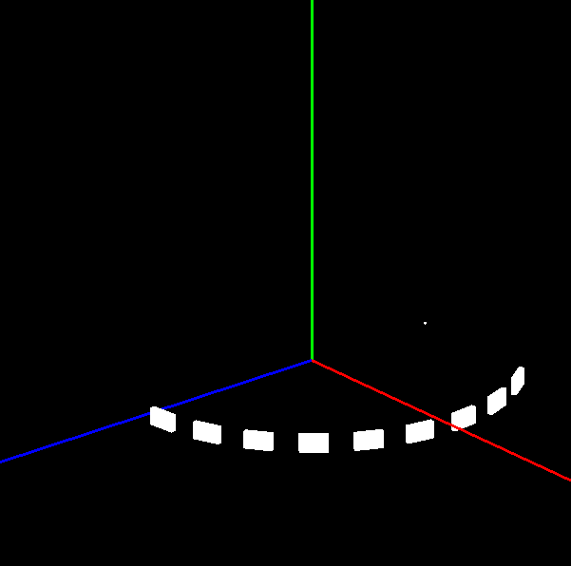
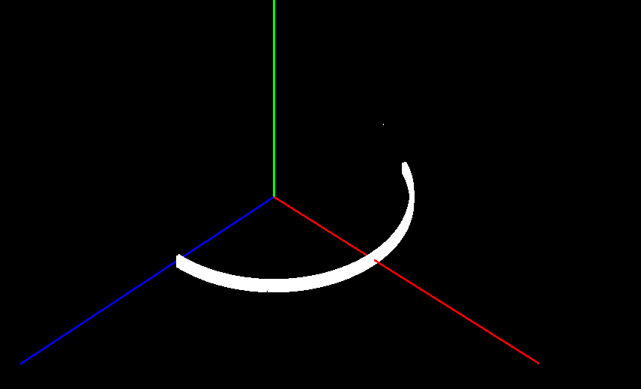
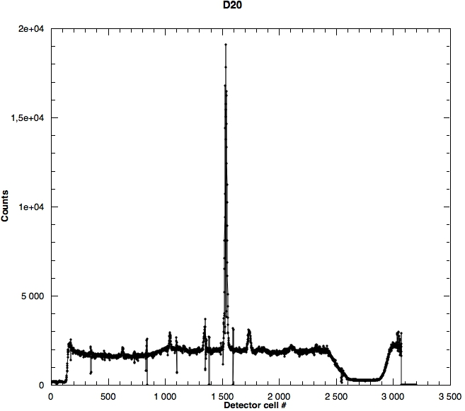
D4
Powder diffraction
D20
Loaders for D1B & D20
First D20 NeXuS files last week
IDFs for D2B & D4C
June 2017:
Reading multiple files & visualization (thermodiffractograms)
Calibration & standard corrections
Export → E.g. Fullprof / GSAS
Scans (e.g. omega-scans → texture)

Slide 11
Framework changes
Mantid 4.0
Initial discussions. Real work to start in May 2017.
New graphical interface.
Plotting improvements (Matplotlib).
“Cleaning” algorithms.
Move to Python 3
Instrument 2.0
New instrument geometry.
Increase flexibility and performance.
Much more adapted framework to treat scanning instruments.
Work initiated in February. Scanning instruments expected to be ready before summer.
Technique / instrument documentation

Slide 12
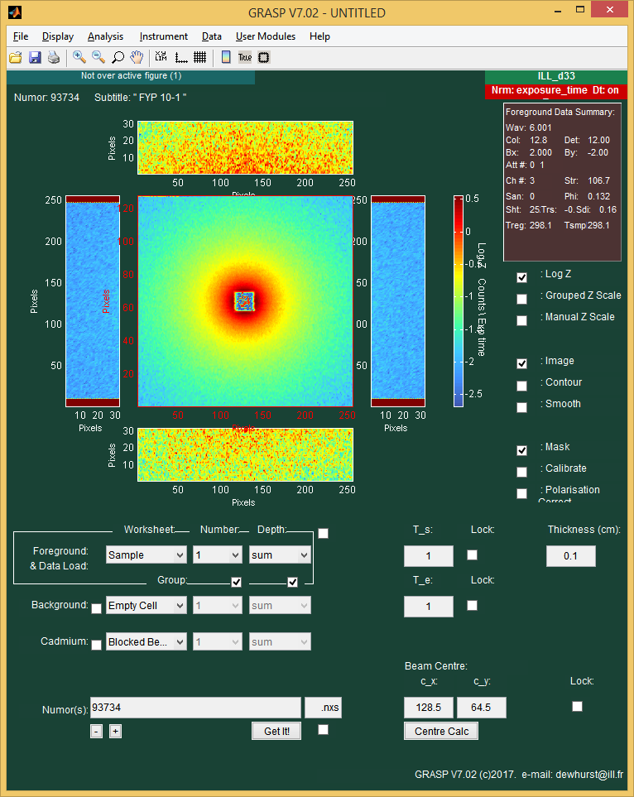
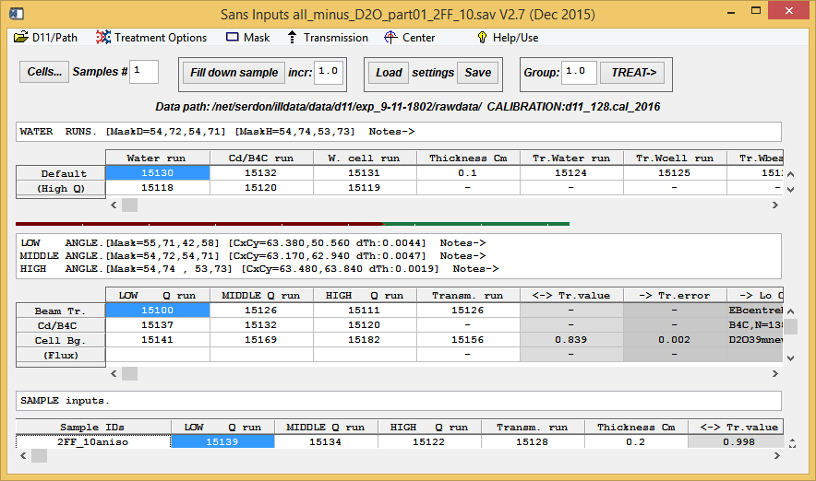
Other work planned for 2017
SANS
Plan to start after summer
First discussions with instrument scientists
Reference soft: Lamp / Grasp
Define benchmark data

Slide 13
Prolongation of Ian’s contract
One more year: Until April 2018
Additional work in framework
Needed additional manpower
Tasks:
Instrument 2.0 + scanning instruments
Define and provide initial contribution to Mantid 4
Build server
Handling of special data types: BLOSC compression & event mode reader
User training + technical training of future technical project leader
Report of project status at year 2

Slide 14
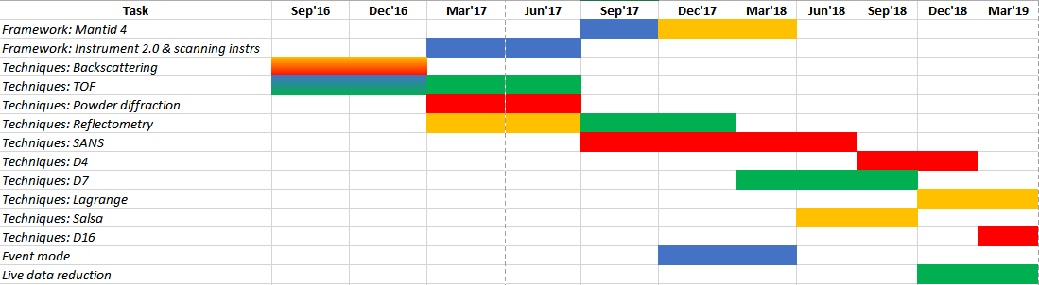
Planning
31st March 2017: Presentation – training spectroscopy group
24-25 April 2017: WP10 – SINE 2020 workshop @ ILL → coordinate efforts with FRM-2 & PSI
12-16 June 2017: Mantid Users & Developers workshops

Slide 15
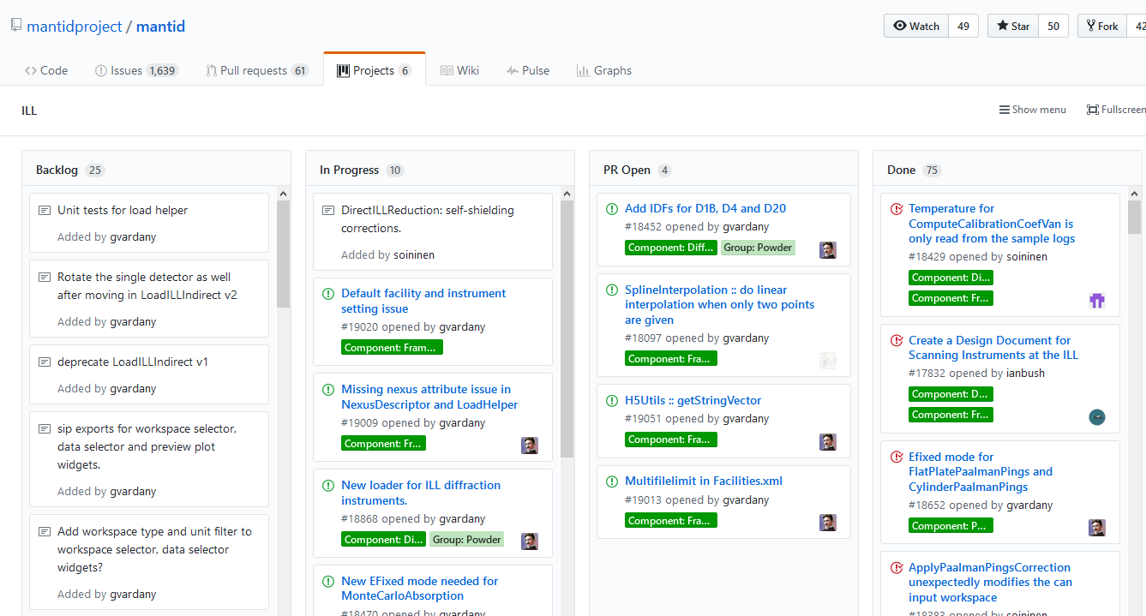
Project info
https://github.com/mantidproject/mantid/projects/2
https://github.com/mantidproject/documents/tree/master/Project-Management/ILL

Slide 16
Summary
Reasonable progress after 10 months.
Some delay with respect to original time planning (March 2016):
- Project complexity
- Documentation, tests
- Interaction with other actors (internal/external)
New project plan:
- Changes in CS → Working team redefined
- New tasks added → Enhancement of Mantid framework
About 6-9 PM extra effort → Prolongation of Ian’s contract
Goals:
2017: BS, TOF, Powder Diff, REF
June 2018: SANS

